Slide 1
Course : COMP8029 – IT Security and Risk Management
Period : September / February 20XX
Risk Management - Contingency Planning Within Information Security
Session 01
KDS – Name SME

Slide 2
Objectives
Define and explain information security
Define and explain the basic concepts of risk management
Identify and define the components of contingency planning
Know and understand the role of information security policy in the development of contingency plans
BFS - Binus March 2011

Slide 3
Introduction
The 9/11 disaster required many companies to put their disaster recovery plans into action
In February 1993, a car bomb exploded beneath one of the WTC towers.
Information Week report (2004):
  Almost 80% of businesses affected by a major incident either never reopen or close within 18 months
BFS - Binus March 2011

Slide 4
Introduction (continued)
Companies must create, implement, and test effective plans to deal with incidents and disasters
Information security: an umbrella term for many programs and activities that assure availability of information in organizations
Information security: Confidentiality, Integrity, Availability
An overview of the entire field, understanding of the major components, and overall strategic plan.
Risk management process to guide managerial and technical controls.
BFS - Binus March 2011

Slide 5
Information Security
Information security:
  Defined by Committee on National Security Systems (CNSS) as the protection of information and its critical elements, including systems and hardware
  Based on the C.I.A. triangle concept
C.I.A. triangle concept: based on three critical characteristics of information that give it value:
  Confidentiality
  Integrity
  Availability
BFS - Binus March 2011

Slide 6
Information Security (continued)
Confidentiality:
  When disclosure or exposure to unauthorized individuals or systems is prevented
  Ensures that only those with rights and privileges to access the information are able to do so
  Breaches of confidentiality may threaten the integrity of the information
Integrity:
  Prevention of corruption, damage, destruction, or other disruption of information
BFS - Binus March 2011

Slide 7
Information Security (continued)
Availability:
  Enables authorized users or systems to access information without interference or obstruction, in the required format
Information Security (InfoSec):
  The protection of the confidentiality, integrity, and availability of information in storage, during processing, or in transmission
BFS - Binus March 2011

Slide 8
Key Information Security Concepts
Threat: a category of objects, persons, or other entities that pose a potential risk of loss to an asset
Asset: an organizational resource that is being protected
  Logical asset: Web site, information, or data
  Physical asset: person, computer system, other tangible object
Attack: an intentional or unintentional attempt to cause damage or otherwise compromise information
BFS - Binus March 2011

Slide 9
Key Information Security Concepts
(continued)
Vulnerability: a weakness or fault in the protection mechanisms for information assets
Well-known vulnerabilities: vulnerabilities that have been examined, documented, and published
Exploit:
  Illegal use of a system or information asset
  A targeted solution to misuse a specific hole or vulnerability
BFS - Binus March 2011

Slide 10
Key Information Security Concepts
(continued)
Control, safeguard, or countermeasure: security mechanisms, policies, or procedures to successfully counter attacks, reduce risk, resolve vulnerabilities, and improve security
BFS - Binus March 2011

Slide 11
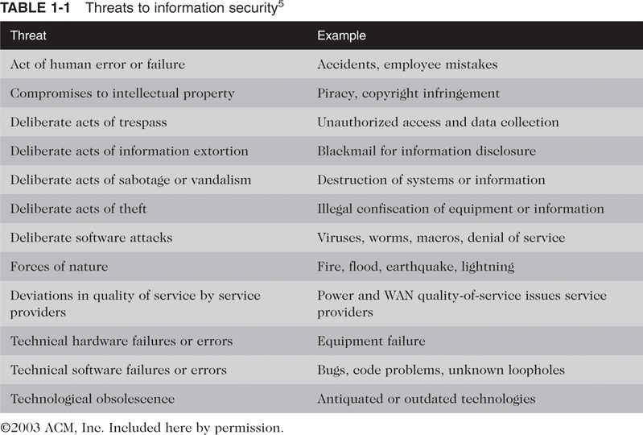
Key Information Security Concepts
(continued)
BFS - Binus March 2011

Slide 12
Threat Categories
Acts of human error or failure:
  Acts performed without intent or malicious purpose by authorized users
Compromises to intellectual property (IP):
  Breaches in the controls placed around IP such as copyrights, trade secrets, trademarks, patents
  Most common IP breach: software piracy
Deliberate acts of trespass: unauthorized individual gains access to information being protected
  Hacker: uses software to gain access to information illegally
BFS - Binus March 2011

Slide 13
Threat Categories (continued)
Deliberate acts of information extortion:
  Demanding compensation for the return or nondisclosure of information obtained by attacker or trusted insider
Deliberate acts of sabotage or vandalism:
  Attempts to destroy an asset or damage the image of an organization
  Cyberterrorist: hacks systems to conduct terrorist activities through network or Internet pathways
Deliberate acts of theft:
  Illegal taking of another’s property
BFS - Binus March 2011

Slide 14
Threat Categories (continued)
Deliberate Software Attacks:
  Malware:
    Malicious code or malicious software components designed to damage, destroy, or deny service to the target system
    Includes viruses, worms, Trojan horses, logic bombs, backdoors, denial of service (DoS), and distributed denial of service (DDoS) attacks
BFS - Binus March 2011

Slide 15
Threat Categories (continued)
Viruses:
  Segments of code that perform malicious actions
  Attached to existing programs
  Macro virus: embedded in automatically executing macrocode; common in word processing documents, spreadsheets, database applications
  Boot virus: infects key operating system files
Worms:
  Malicious programs that replicate themselves without requiring another program
  Can replicate through email, Web servers, network shares
BFS - Binus March 2011

Slide 16
Threat Categories (continued)
Backdoors and Trapdoors:
  A payload carried by a virus or worm that installs on a system allowing penetration and control of the system remotely
  Examples: Subseven, Back Orifice
Polymorphism:
  Virus or worm that evolves, changing its size and appearance over time
BFS - Binus March 2011

Slide 17
Threat Categories (continued)
Propagation Vectors:
  Ways that malicious code is spread from one system to another
  Trojan: a common propagation method in which the infected program appears to be a desirable program
  Social engineering: getting the user to perform an action that enables the attack or infection
Virus and Worm Hoaxes:
  Require as much time and effort to combat as real virus and worm threats
BFS - Binus March 2011

Slide 18
Threat Categories (continued)
Forces of Nature (force majeure):
  Unexpected and often unpredictable
  Includes fire, flood, earthquake, lightning, hurricanes, volcanic eruption, insect infestation
  Often affect personnel as well as equipment
Deviations in Quality of Service, by Service Providers:
  Products or services not delivered (electricity, water, network bandwidth, etc.)
BFS - Binus March 2011

Slide 19
Threat Categories (continued)
Technical Hardware Failures or Errors:
  Defects that cause a system to perform outside of expected parameters
  Causes unreliable service or lack of availability
  Errors can be intermittent or terminal
Technical Software Failures or Errors:
  Includes bugs and untested failure conditions
  May include intentional shortcuts left by programmers for benign or malicious reasons
Technical Obsolescence:
  Antiquated or outdated infrastructure leads to unreliable and untrustworthy systems
BFS - Binus March 2011

Slide 20
Overview of Risk Management
Risk Management:
  Formal process of identifying and controlling risks to an organization’s information assets
Risk Identification:
  Process of examining and documenting the security posture of an organization’s information technology
Risk Control:
  Process of applying controls to reduce the risks to data and information systems
BFS - Binus March 2011

Slide 21
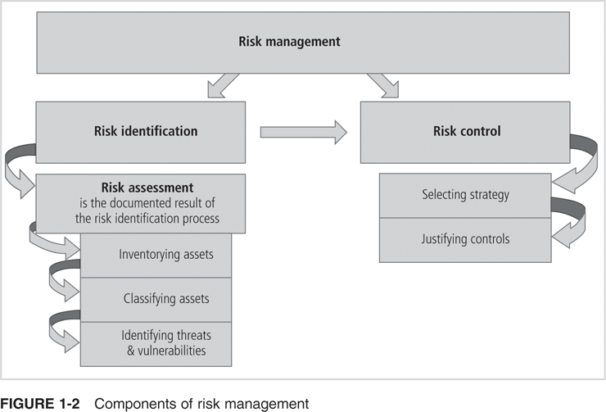
Overview of Risk Management (continued)
BFS - Binus March 2011

